Slide 1
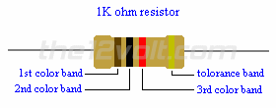
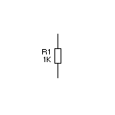
Resistor
Circuit Symbol
Resistors are used to limit the current in a circuit.
Resistance is measured in ohms (Ω)
Ohm’s law states that the direct current flowing in a resistor is directly proportional to the potential difference between its ends.
V = IR
V is the potential difference, or
voltage,
I is the current, and
R is the resistance.

Slide 2
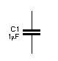
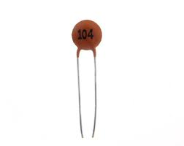
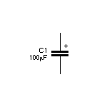
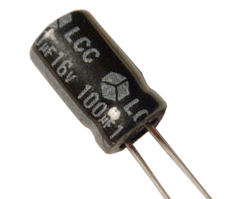
Capacitor
Circuit Symbol
The capacitor is a component which is used to store electric charge.
The amount of electric charge that a capacitor can hold depends on its capacitance. This is measured in Farads (F).
Small capacitors are able to withstand high voltages, and they can be connected either way round.
Large ‘electrolytic’ capacitors can only withstand small voltages, and they must be connected with the positive lead to the positive side of the circuit and the negative lead to the negative side.
Small capacitor
Large ‘electrolytic’ capacitor

Slide 3
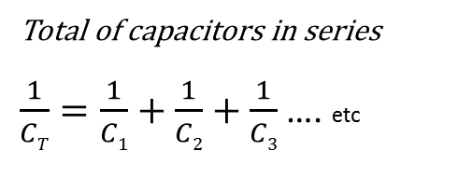
Capacitors
Capacitance (picofarad pF) | Capacitance (nanofarad nF) | Capacitance (microfarad µF) | Capacitance Code
10 15 47 82 100 330 470 1000 1500 2200 4700 6800 10000 22000 47000 100000 220000 470000 | 0.01 0.015 0.047 0.082 0.1 0.33 0.47 1.0 1.5 2.2 4.7 6.8 10 22 47 100 220 470 | 0.00047 0.001 0.0015 0.0022 0.0047 0.0068 0.01 0.022 0.047 0.1 0.22 0.47 | 100 150 470 820 101 331 471 102 152 222 472 682 103 223 473 104 224 474
Total of capacitors in series
$\frac{1}{CT}=\frac{1}{C1}+\frac{1}{C2}+\frac{1}{C3}$ …. etc
Total of capacitors in parallel
C_{T} = C₁ + C₂ + C₃ …. etc

Slide 4
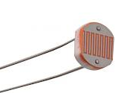
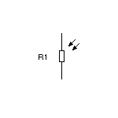
Light dependent resistor (LDR)
Circuit Symbol
A light-dependent resistor is a type of resistor that decreases in resistance when it is exposed to light. Also known as a photoresistor.

Slide 5
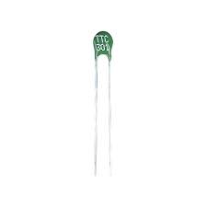
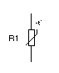
Thermistor
Circuit Symbol
A thermistor is simply an electrical resistor whose resistance changes with temperature.
Commonly the resistance falls exponentially with increasing temperature and such devices are said to have a negative temperature coefficient (NTC).

Slide 6
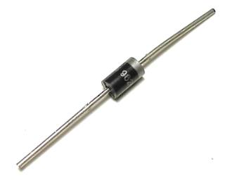
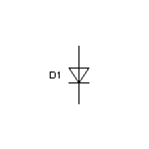
Diode
Circuit Symbol
A diode is a component that allows current to flow in one direction only.
Diodes are normally used to prevent damage to other polarised components in circuits: e.g. a diode can protect against current flowing the wrong way if the battery is put in back to front.
anode
cathode
anode
cathode

Slide 7
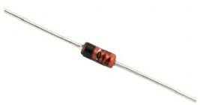
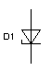
Zener diode
Circuit Symbol
A zener diode is a diode which allows current to flow in the forward direction in the same manner as an ideal diode, but will also permit it to flow in the reverse direction when the voltage is above a certain value known as the breakdown voltage.
anode
cathode
anode
cathode

Slide 8
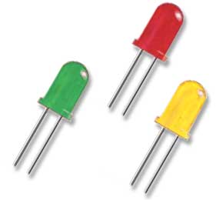
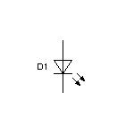
Light Emitting Diode
(LED)
Circuit Symbol
An LED, or Light Emitting Diode, is an electronic device that emits light when an electrical current is passed through it.

Slide 9

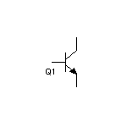
Transistors
Circuit Symbol
Transistors are electronic component used in circuits to control large amounts of current with a small amount current.

Slide 10
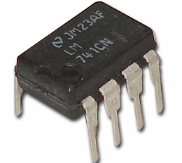
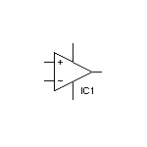
Operational amplifier (Op Amp)
Circuit Symbol
An operational amplifier (op-amp) is a high-gain electronic voltage amplifier with a differential input and an output. An op-amp produces an output voltage that is typically hundreds of thousands of times larger than the voltage difference between its input terminals.

Slide 11
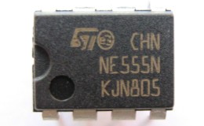
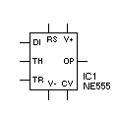
555 timer IC
Circuit Symbol
The 555 timer IC is an integrated circuit (chip) used in a variety of timer, pulse generation, and oscillator applications.
The 555 can be used to provide time delays, as an oscillator, and as a flip-flop element.

Slide 12
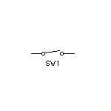
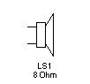
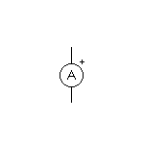
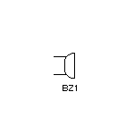
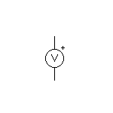
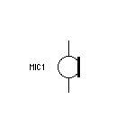
Other circuit symbols
Loudspeaker
Switch
Ammeter
Buzzer
Voltmeter
Microphone

Slide 13
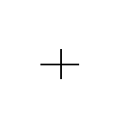

Wires crossing
Wire junction
Circuit Symbol
Wires crossing no connection
Circuit Symbol
Wires connected together

Slide 14
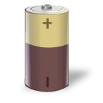
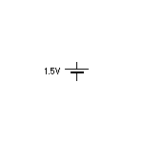
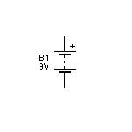
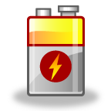
Battery
Circuit Symbol

Slide 15
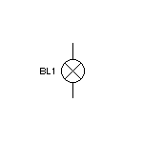
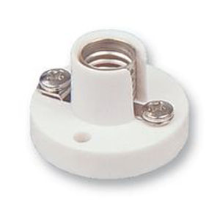
Bulb
Circuit Symbol
Bulb holder

Slide 16
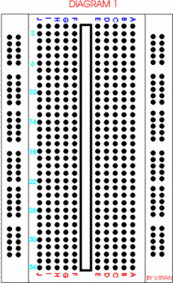
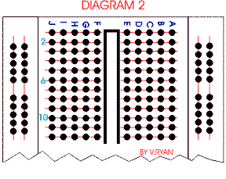
Breadboard
Breadboards are used to construct and test circuits.
Wires and components are simply pushed into the holes to form a completed circuit and power can be applied.
One of the main advantages of using a breadboard is that the components are not soldered and if they are positioned incorrectly they can be moved easily to a new position on the board.

